Slide 1

Open-Source Communities
Sicherheit bei Open Source Projekten
Gruppe 18 Vorlesung Digitale Nachhaltigkeit 2022
14./21. Dezember 2022
Paco Eggimann
Flavio Gerber
Tobias Brunner
Forschungsstelle Digitale Nachhaltigkeit
Institut für Informatik
Universität Bern

Slide 2
Agenda
WISSENSCHAFTLICHER TEIL
PRAKTISCHER TEIL
PERSÖNLICHES FAZIT

Slide 3
Open vs. Closed Source Sicherheit
Given enough eyeballs, all bugs are shallow
- Linus’s Law
Heartbleed
Shellshock

Slide 4
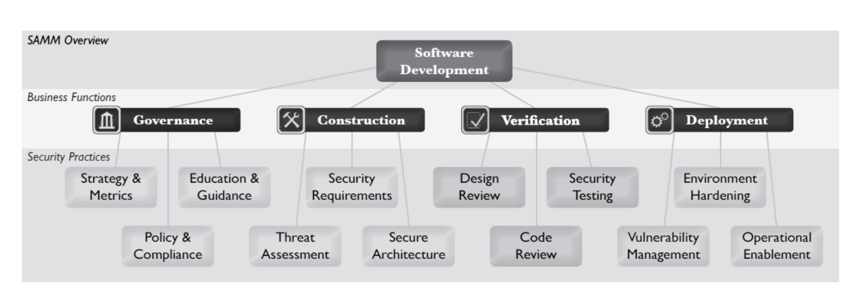
Software Development: Security

Slide 5
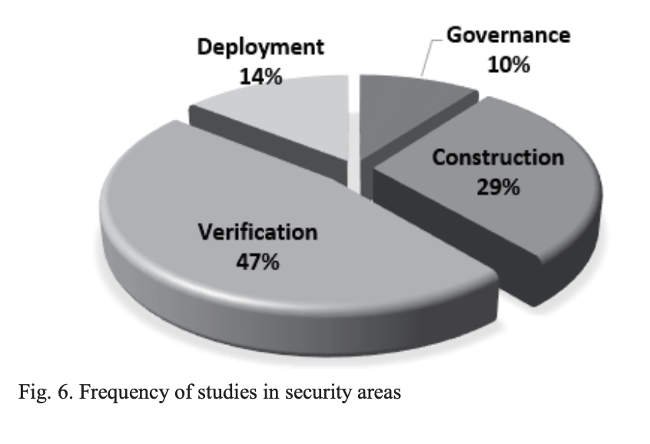
Software security in open source development
Review of 42 papers with regard to
Security areas of the selected studies
Shao-Fang Wen (2017) Software security in open source development: A systematic literature review

Slide 6
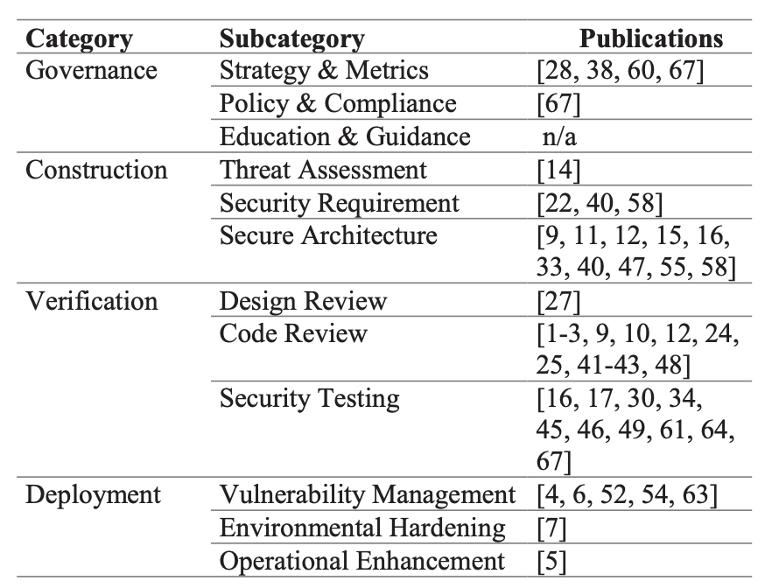
Software security in open source development
Verification
Vulnerabilities in design will manifest themselves in code review or security testing if not detected earlier
Construction
Secure system design
Deployment
OpenSource lacks corporate management
Governance
In OpenSource lack of security knowledge is common
Shao-Fang Wen (2017) Software security in open source development: A systematic literature review

Slide 7
Software security in open source development
Construction & verification are followed with more interest than other areas
Studies which focus on developement are technically driven and social aspects neglected
Lack of knowledge management in OSS security
Shao-Fang Wen (2017) Software security in open source development: A systematic literature review

Slide 8
Agenda
WISSENSCHAFTLICHER TEIL
PRAKTISCHER TEIL
PERSÖNLICHES FAZIT

Slide 9
Puzzle ICT: Verification
Security departement
Verification of running deployements
Examination of security threats
Verification of deployments before they become productive
QUELLE/LINK

Slide 10
Puzzle ICT: Construction
Use of known and proven frameworks mitigate security risks
Code reviews with security departement during later stages of developement
QUELLE/LINK

Slide 11
Puzzle ICT: Governance
Regelmässige Sicherheitsschulungen
Vorhandenes Knowhow wird in allen Stages des Developements eingesetzt
Fehlerkultur
QUELLE/LINK

Slide 12
Puzzle ICT: Deployement
Eigene Abteilung für deployement
Enge Zusammenarbeit mit Securityabteilung
Verwendung von «proven» Frameworks
Openshift
QUELLE/LINK

Slide 13
Agenda
WISSENSCHAFTLICHER TEIL
PRAKTISCHER TEIL
PERSÖNLICHES FAZIT

Slide 14
UNSER FAZIT
With great power comes great responsibility
OSS easy target if left unprotected
enforcing security policies throughout the software development lifecycle
Open vs closed source:
Enforcing security standards and best practices during the development process have the best chance of making a software robust

